Slide 1
Novice Programmers
Lecture Series.
Fahad S. Ahmed, MBBS, MD, ABAIM

Slide 2
Lectures
Lecture 1: Computer literacy
Lecture 2: Programming Languages
Lecture 3: Python coding 1: Basics
Lecture 4: Python coding 2: Files and folders
Lecture 5: Python coding 3: Statistics and graphs
Lecture 6: Python coding 4: Basic Machine Learning

Slide 3
Lecture 1: Computer literacy

Slide 4
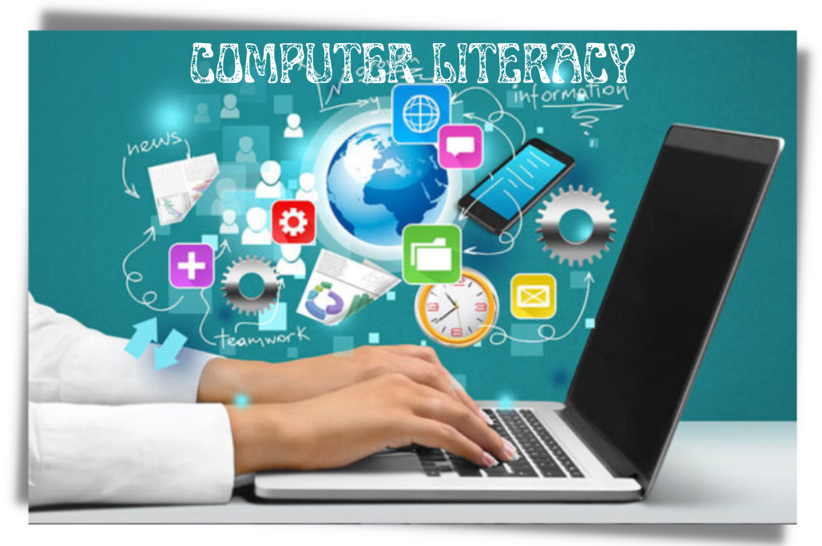
Define computer literacy
Computer literacy is the ability to use computers effectively for various tasks, from basic to advanced.
In today's digital age, computer literacy is crucial for personal, educational, and professional success.

Slide 5
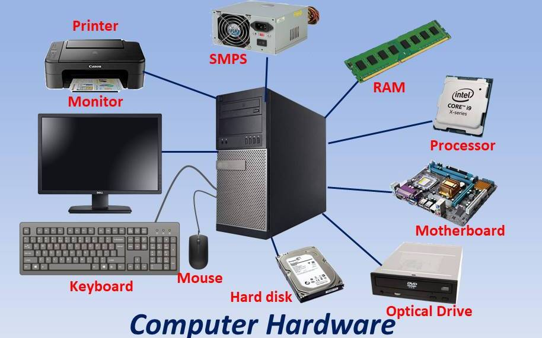
Basic Components of a Computer
Hardware refers to the physical parts of a computer, such as the Central Processing Unit (CPU), monitor, keyboard, and mouse.
Hardware:
CPU: Core i5, Core i7, Core i9, etc
monitor: Phillips, Samsung, etc
Input devices:
keyboard, mouse, etc

Slide 6
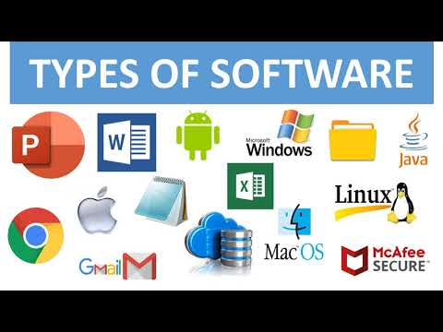
Basic Components of a Computer
Software encompasses the programs and instructions that run on a computer, including the operating system and applications.
Software:
Operating systems: Windows 10, MacOS, Ubuntu, etc
Applications:
End-user: Microsoft Word / Excel / Powerpoint, etc
Prograaming applications: Python, R language, C language, etc
etc.

Slide 7
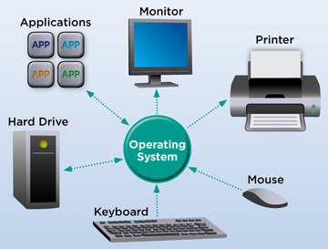
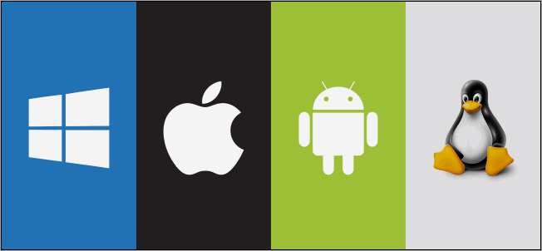
Operating Systems
An operating system is software that manages computer hardware and provides a user interface for interacting with the computer.
Examples of operating systems include Windows, macOS, and Linux, each with its unique features and functions.

Slide 8
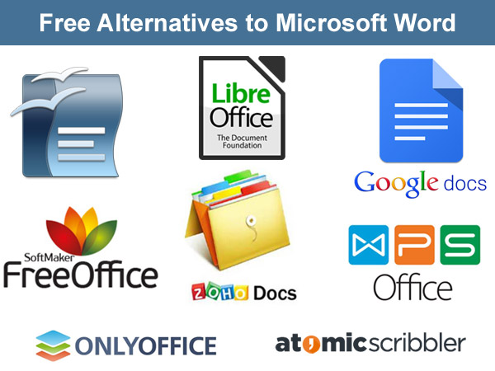
Common Software Applications
Word processing software (e.g., Microsoft Word, Google Docs) is used for creating and editing text documents.

Slide 9
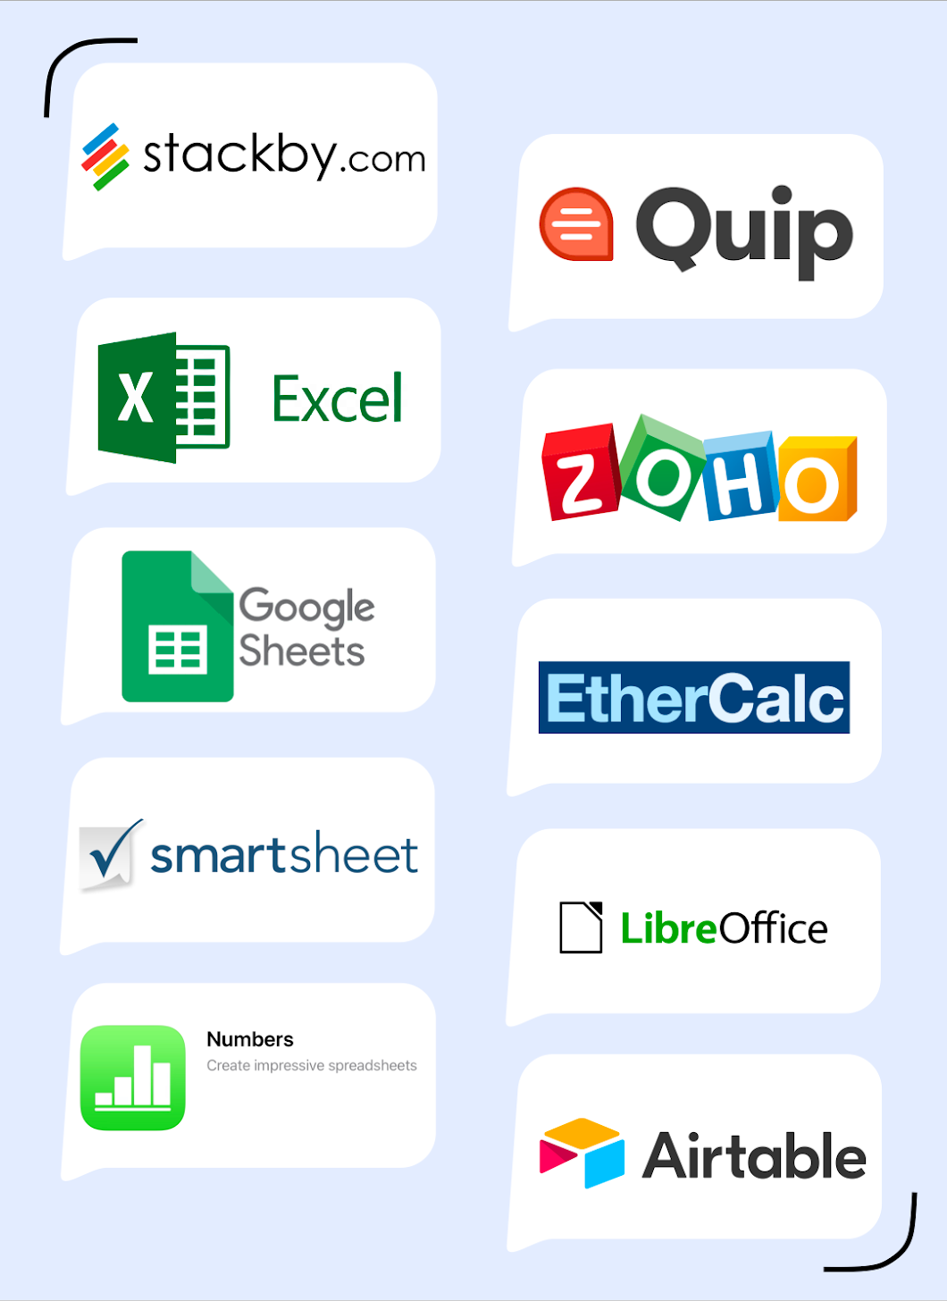
Common Software Applications
Spreadsheets (e.g., Microsoft Excel, Google Sheets) are used for organizing and analyzing data.

Slide 10
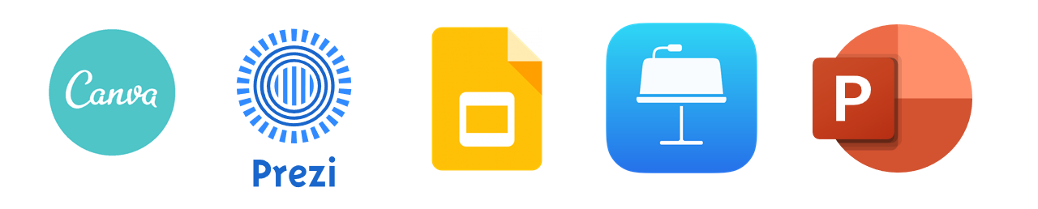
Common Software Applications
Presentation software (e.g., Microsoft PowerPoint, Google Slides) helps create visual and engaging slideshows.

Slide 11
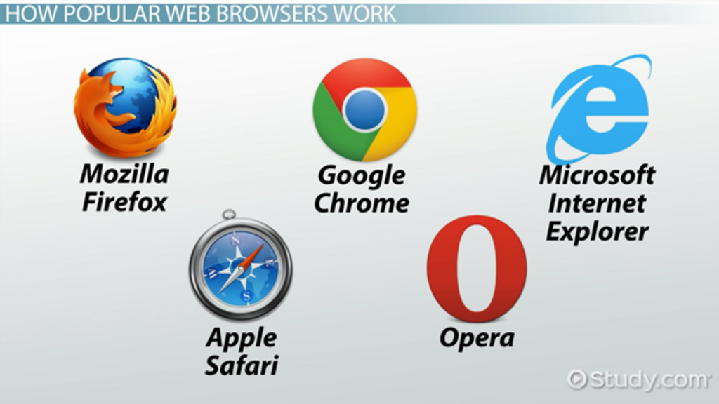
Common Software Applications
Web browsers (e.g., Google Chrome, Mozilla Firefox) allow users to access and navigate websites on the internet.

Slide 12
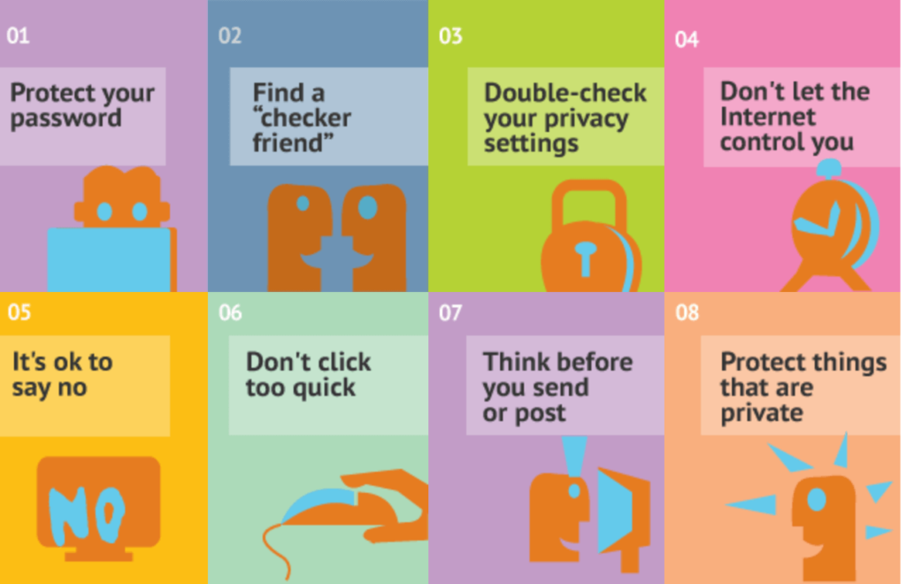
Internet and Online Safety
Online safety involves protecting personal information, avoiding cyber threats, and practicing safe online behavior.
Tips include using strong, unique passwords, being cautious of suspicious links and emails, and keeping software up to date.

Slide 13
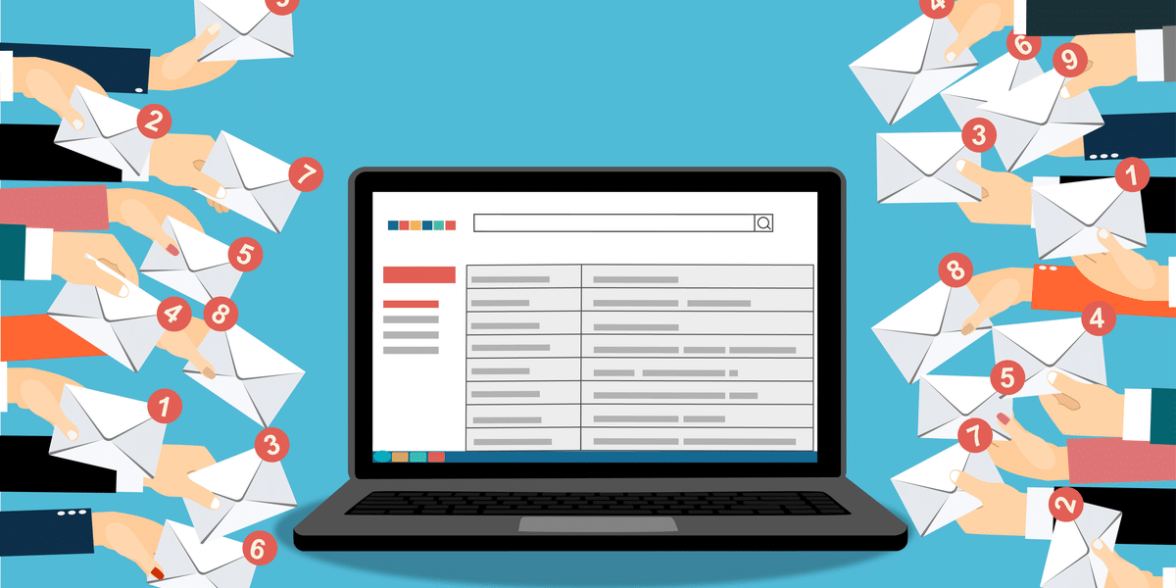
Email and Communication
Email is a common method of electronic communication, allowing users to send and receive messages.
Netiquette refers to proper etiquette and behavior when communicating online, including being respectful and concise.

Slide 14
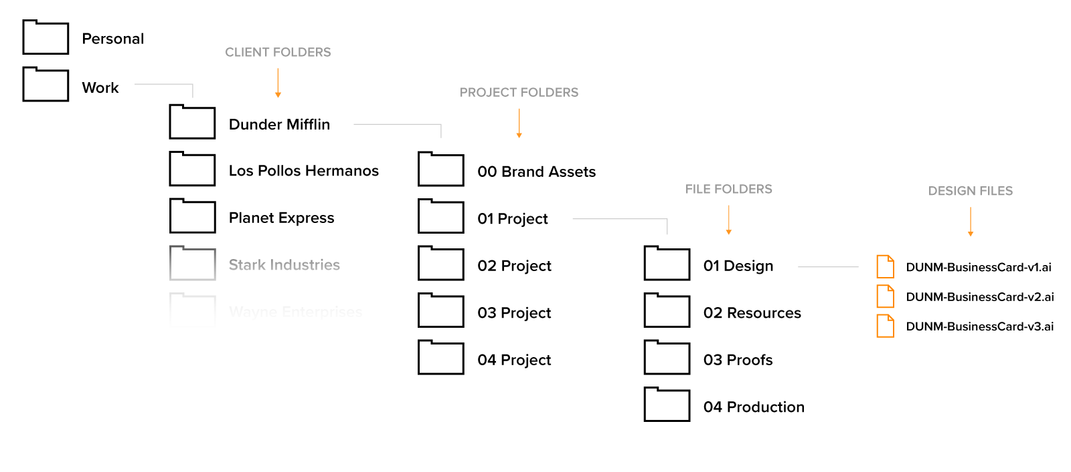
File Management
File management involves organizing and storing digital files and documents in a logical and accessible manner.
Regular backups help prevent data loss and ensure important files are not accidentally deleted.

Slide 15
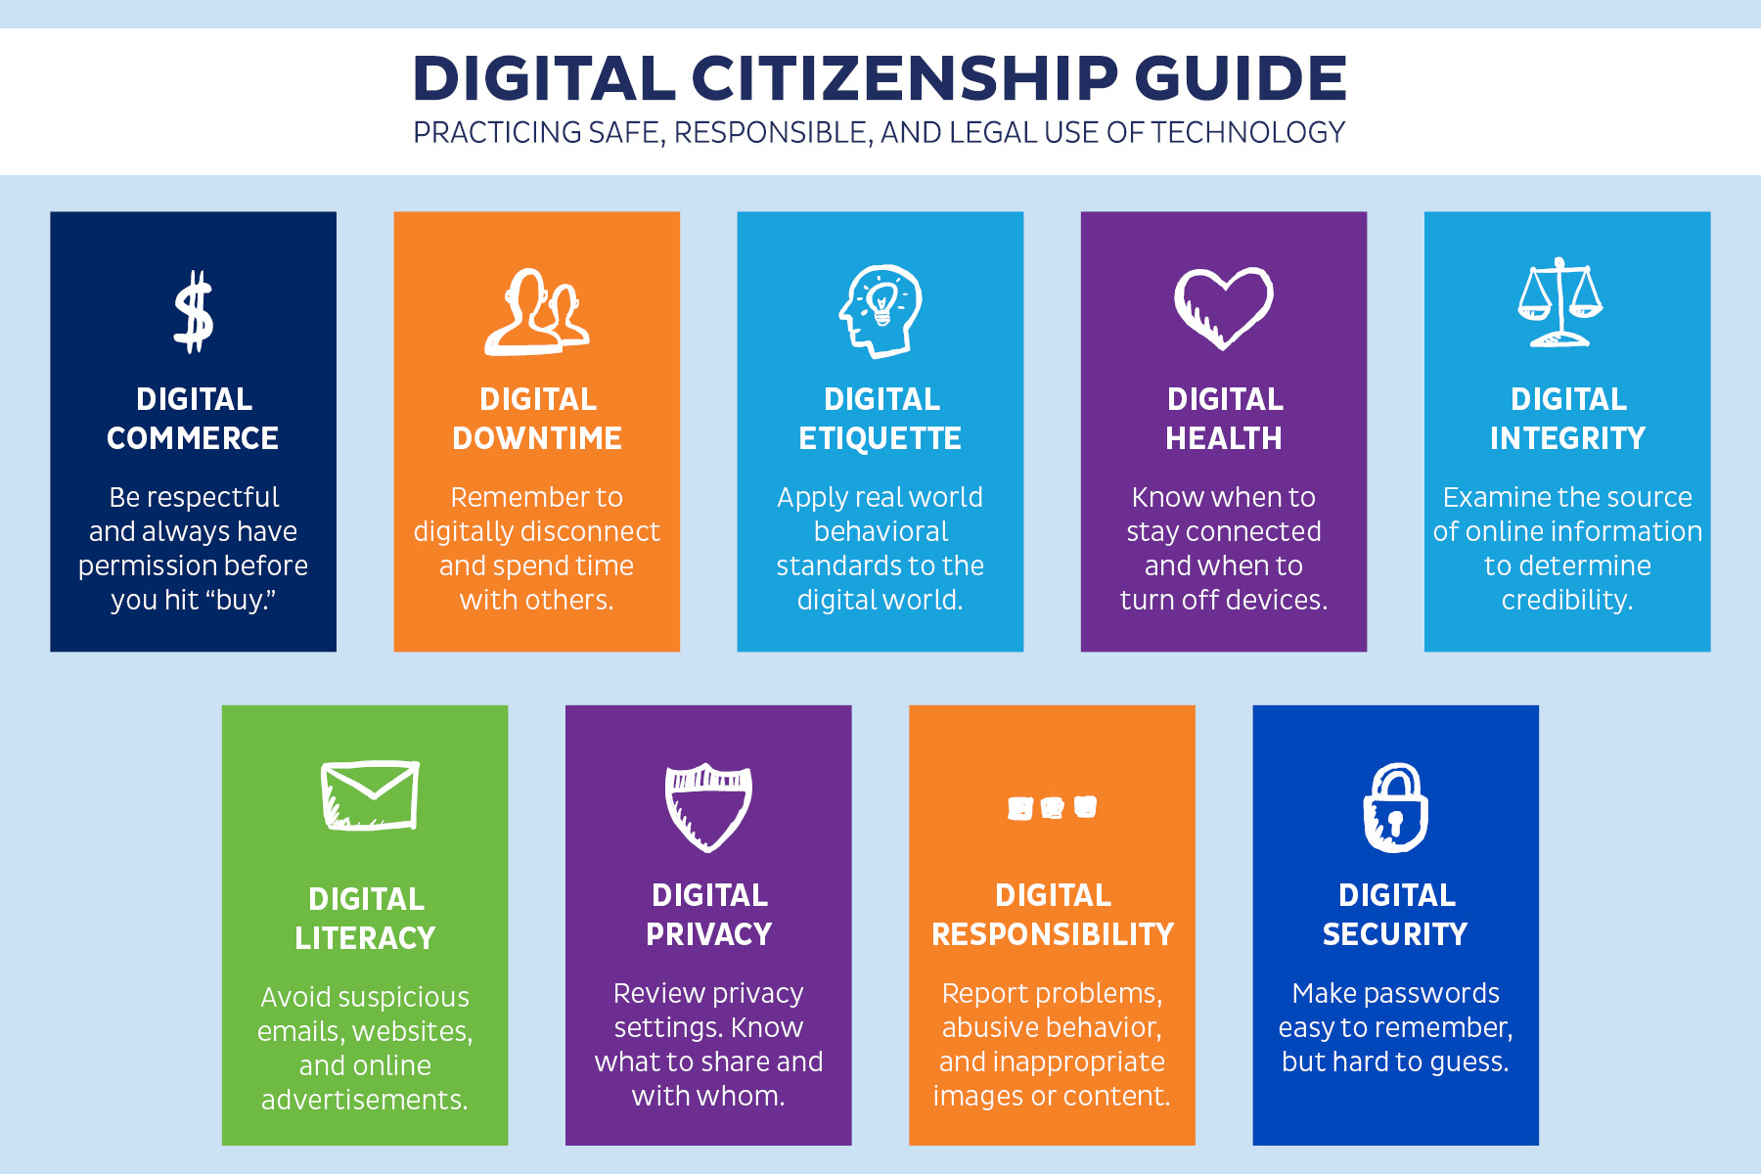
Digital Citizenship
Digital citizenship involves responsible and ethical use of technology, respecting others' rights, and avoiding online plagiarism.
It also includes considerations of copyright and intellectual property when using online resources.

Slide 16
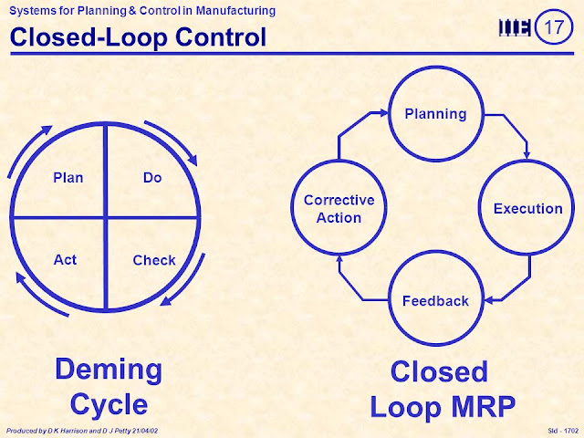
Troubleshooting and Problem-Solving
Troubleshooting involves identifying and resolving common computer issues, such as software glitches and hardware malfunctions.
Resources for troubleshooting include online forums, user manuals, and contacting technical support.

Slide 17
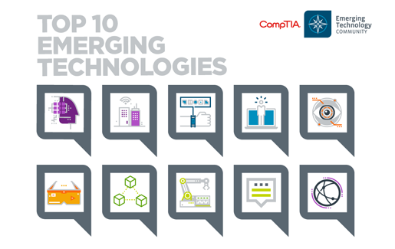
Emerging Technologies
Emerging technologies like Artificial Intelligence (AI), Internet of Things (IoT), and blockchain are shaping the future of technology.
These technologies have implications for various industries and everyday life, from smart devices to data analysis.

Slide 18
Conclusion
Introduction to Computer Literacy
Basic Components of a Computer
Operating Systems
Common Software Applications
Internet and Online Safety
Email and Communication
File Management
Digital Citizenship
Troubleshooting and Problem-Solving

Slide 19
Questions:
Question 1: What is the primary purpose of computer literacy?
a) Playing video games
b) Understanding and using computers effectively
c) Collecting stamps
d) Watching movies
Question 2: Which of the following is considered a hardware component of a computer?
a) Microsoft Word
b) Google Chrome
c) CPU
d) Operating System
Question 3: Which of the following is an example of an operating system?
a) Microsoft Excel
b) Google Docs
c) Windows
d) Microsoft PowerPoint
Question 4: What does "online safety" refer to?
a) The color scheme of a website
b) Safe driving practices
c) Responsible behavior on the internet
d) Keeping your computer offline onsible use of technology and online behavior
c) Playing online video games
d) Using a digital camera

Slide 20
Questions:
Question 5: Which software application is commonly used for creating slide-based presentations?
a) Microsoft Word
b) Microsoft Excel
c) Google Slides
d) Photoshop
Question 6: What is "netiquette"?
a) A type of software application
b) Proper online communication etiquette
c) A computer virus
d) A programming language
Question 7: Which component of a computer is responsible for processing data and performing calculations?
a) Monitor
b) Keyboard
c) CPU
d) Mouse
Question 8: Why is it important to have strong passwords?
a) To impress your friends
b) To make them easy to remember
c) To protect your online accounts from unauthorized access
d) To increase the speed of your internet connection

Slide 21
Questions:
Question 9: What does "digital citizenship" refer to?
a) Citizenship in a foreign country
b) Responsible use of technology and online behavior
c) Playing online video games
d) Using a digital camera
Question 10: Which emerging technology has the potential to connect everyday objects to the internet?
a) Artificial Intelligence (AI)
b) Internet of Things (IoT)
c) Virtual Reality (VR)
d) Quantum Computing

Slide 22
Next time
Lecture 2: Programming Languages

